Slide 1
Housing Affordability in Canada
DAB 402 - Capstone Group Presentation
Group 002
Akshar Patel(0793127)
Hiren Patel(0797548)
Jigar Patel(0794004)
Kush Patel(0792972)
GitHub Link: Click Here

Slide 2
TABLE OF CONTENTS
01
02
03
04
Introduction
Problem Identification
Analytical Statement
Data Description
05
06
Data Assessment
Data Preprocessing & EDA
07
08
Future Planning
References

Slide 3
Introduction
In Canada, housing affordability is a critical issue. It impacts all Canadians, whether they are renters, homeowners, or property buyers. The housing affordability problem in Canada affects not just those on low salaries, but also those who are in the middle class.
Housing costs in Canada have significantly risen over the last decade, making it difficult for many Canadians to obtain and maintain appropriate accommodation.
Housing affordability will worsen over time due to a scarcity of dwellings, a preference for single-family homes over high-rises, and rising mortgage rates.
To appreciate Canada's future housing affordability and identify the cities most likely to have a housing crisis, research is necessary.
This presentation will look at the elements that are contributing to Canada's housing affordability problems and suggest potential remedies.

Slide 4
Problem Identification
The Canadian home affordability problem has had a profound impact on Canadians. Many individuals lack access to sufficient housing, and those who do have access to housing frequently struggle to make their rent or mortgage payments. As a result, there has been an upsurge in homelessness and housing instability in Canada.
The home affordability problem has also had a detrimental economic impact. High housing costs have resulted in increased household debt, which has reduced consumer spending and investment. This has harmed the Canadian economy, lowering economic growth and jobs.

Slide 5
Analytics Statement
“How has the affordability of housing in Canada changed over time and what factors have contributed to these changes?”
The objective of the project is to assess the potential home affordability landscape in Canada for the foreseeable future.
In Canada, housing affordability is complicated and impacted by a variety of factors such as income, interest rates, policies, and regional markets. While certain locations have stabilized, COVID-19 uncertainty and price fluctuations may have an impact on affordability. To inform policy choices and increase housing affordability for all Canadians, continuous monitoring and analysis are required.

Slide 6
Dataset Description
Source: Housing affordability in Canada
Attributes:
Frequency: Monthly
Table: 18-10-0205-01 (formerly CANSIM 327-0056)
Release date: 2022-05-19
Geography: Canada, Geographical region of Canada, Province or territory, Census metropolitan area, Census agglomeration
Population to dwellings data:
Provides population and housing numbers for several areas in 2021.
Structure to dwelling data:
Provides the number of homes, the number of people living in those units, and the average household size for the year 2021.
Consumer Price Index(CPI) inflation data:
Range : 1911 - 2021, by region

Slide 7
Dataset Description Cont.
Population data:
Range : 1946- 2022, by region
Data on housing supply, price, and rental rates:
It includes csv files for 34 cities.
Range - 1990 – 2016
Provides information on new developments, rental rates, and vacancy rates.

Slide 8
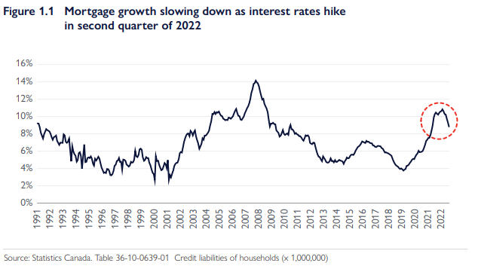
Data Assessment
Current State of Housing Affordability in Canada
According to the most recent Canada Mortgage and Housing Corporation (CMHC) data, home affordability in Canada is at its lowest point in more than a decade.
The CMHC's Housing Affordability Index (HAI) assesses the proportion of families in a particular area that can afford to buy a home. The housing affordability index (HAI) in Canada is now at its lowest level since 2008, showing that housing is becoming increasingly costly for many Canadians.

Slide 9
Data Assessment Cont.
Factors Influencing Housing Affordability in Canada
A variety of variables impact home affordability in Canada. They include the cost of land, housing availability, building costs, and finance costs. Moreover, government regulations such as zoning and taxation can affect home affordability.
One of the most important elements impacting house affordability in Canada is the cost of land. Land prices have risen dramatically in recent years, making it more difficult for Canadians to buy a home.
Potential Solutions to Improve Housing Affordability in Canada
There are several potential options for increasing home affordability in Canada. They include making more inexpensive housing available, lowering the cost of land, and instituting incentives to stimulate the building of affordable housing.
Furthermore, the government can implement policies that minimize the cost of borrowing and give tax breaks to stimulate the creation of affordable housing. These policies have the potential to make housing more affordable for Canadians.

Slide 10

Data Preprocessing
Step 1: Import required libraries
Pandas is a popular open-source Python library for data science/data analysis and machine learning activities. It is constructed on top of Numpy, another library that supports multidimensional arrays.
NumPy is a Python library for manipulating arrays. It also has functions for working with linear algebra, the Fourier transform, and matrices.
Matplotlib is a Python package that allows you to create static, animated, and interactive visualizations. Matplotlib makes simple things simple and difficult things possible. Make plots that are suitable for publishing. Create interactive figures that can be zoomed, panned, and updated.

Slide 11
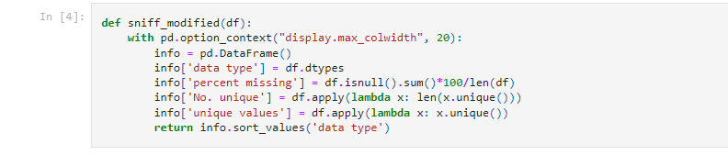
Data Preprocessing Cont.
Step 2: Use Sniff() Function
The sniff() function returns information about all the packets that has been sniffed.
Here, we need information of dataset such as data type, missing values, unique values.

Slide 12
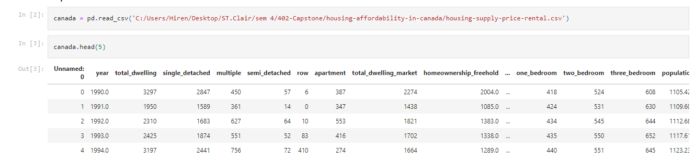
Data Preprocessing Cont.
Step 3: Load Dataset
Load dataset by using pandas library and using head(5) function we display our first 5 rows of data.

Slide 13
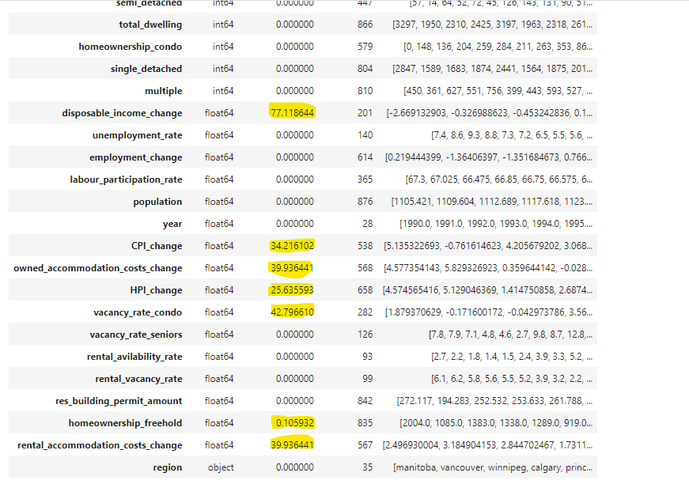
Data Preprocessing Cont.
Step 5: Check & Remove Null Values
Highlighted columns have missing values.
Columns: Disposable_income_change, CPI_change, owned_accommodation_costs_change, HPI_change, vacancy_rate_condo, homeownership_freehold, rental_accommodation_costs_change
Using dropna() method we remove the rows that contains NULL values.

Slide 14
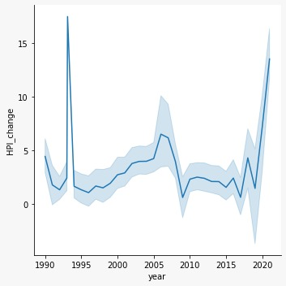
Exploratory Data Analysis
The House Price Index (HPI) is a measure of the variation of prices for residential properties sold in a certain market or region over time. Typically, the HPI tracks the prices of single-family homes, townhouses, and condos.
According to an analysis of the House Price Index (HPI) graph, the trend in the 1990s was roughly 5%. Nevertheless, throughout the next three decades, the HPI fluctuated but eventually climbed to 15%.

Slide 15
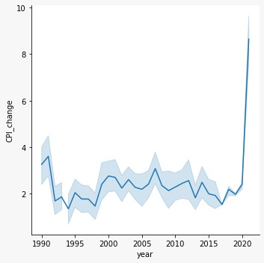
Exploratory Data Analysis Cont.
The Consumer Price Index (CPI) measures the average change in consumer prices for a basket of goods and services over time. The CPI measures the costs of a wide range of goods and services often purchased by families, such as food, housing, clothes, transportation, medical care, and recreation.
Based on an analysis of the Consumer Price Index (CPI) graph, it can be observed that although the ratio of CPI in the past years was relatively low compared to recent years, there has been a significant increase in the rate of change of CPI over the last two years.

Slide 16
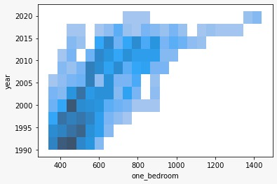
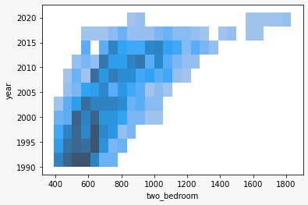
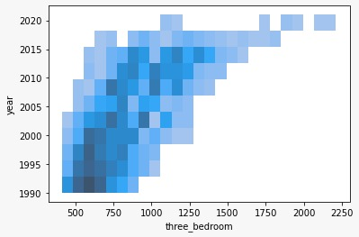
Exploratory Data Analysis Cont.
As we can see from the graphs, over the course of three decades, there was a consistent upward trend in the rental rates for one-bedroom, two-bedroom, and three-bedroom houses.

Slide 17
Future Planning
In the next phase, we intend to apply our datasets to various Machine Learning Models to forecast future trends concerning house availability, rental rates, Consumer Price Index (CPI) and mortgage rates.
Furthermore, we plan to create visually compelling Dashboards that will contain a comprehensive overview of information pertaining to house availability, rental rates, mortgage rates, CPI rates, Housing Price Index (HPI) rates, and their impact on the S&P 500 share market.

Slide 18
References
OECD.STAT
Canada Mortgage and Housing Corporation (CMHC)
Statistics Canada
Canadian Real Estate Association (CREA)
Bank of Canada

Slide 19
THANKS
Does anyone have any questions?

